Slide 1



Stefano D’Onofrio OpenId Connect in Asp.net Core using IdentityServer4
donofrio.stefano84@gmail.com
https://github.com/stefanodonofrio
https://www.linkedin.com/in/stefano-d-onofrio-5447a284/

Slide 2

Makers of the top-rated and best-selling dog activity monitor in the UK.
A multidisciplinary team of engineers, vets and dog-lovers based in central Cambridge.
Some call us the ‘Fitbit for dogs’.

Slide 3
We use the latest technologies across our product:
Xaramin Forms
Asp.net Core
Azure Devops for CI
Azure Datalake
Our team is growing & we’re always on the lookout for passionate Software Developers, QA & DevOps.
talent@pitpatpet.com

Slide 4
Agenda
Part 1
Life before OAuth2 (Social Media Manager App)
What is OAuth2
Wath is OpenId
Authentication VS Authorization
Grant Types in OAuth2
Authorization code Flow
Token
Security Consideration
Part 2
OAuth2 and OpenId Connect in Asp.net Core
Question Time

Slide 5



Life before OAuth2 (Social Media Manager App)
Social Media Manager App

Slide 6

What is OAuth2
Say that OAuth2 is about
Authentication
Is a standard token-based Authorization protocol that allows third party clients limited access to protected resources

Slide 7

What is OpenId Connect
It is a standard Authentication protocol built on top of OAuth2.

Slide 8
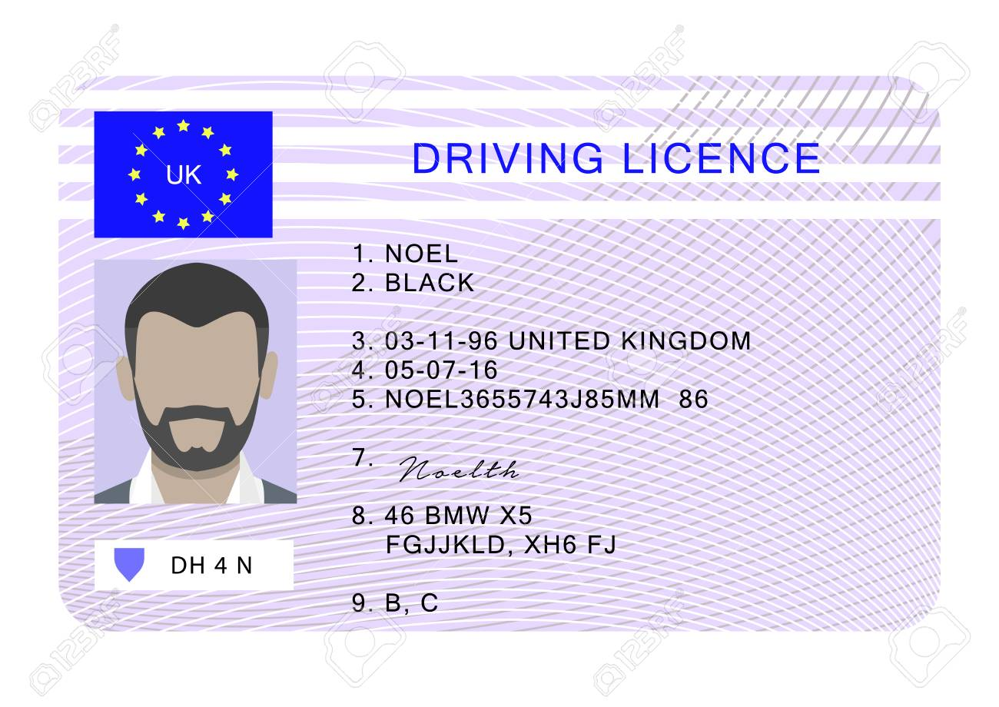
Authorization Vs Authentication
Authentication is about who you are
Authorization is about what you can do

Slide 9

Grant Types
Authorization Code Flow
Authorization Code Flow with PKCE
Implicit Flow
Device Flow
Hibryd Flow
Resource Owner Password Flow
Client Credential Flow
We need only two flows:
Authorization Code Flow with PKCE
Client Credential Flow

Slide 10
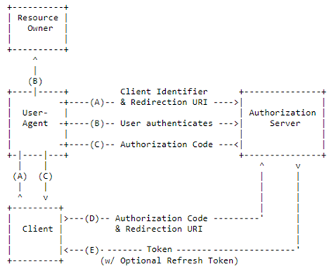
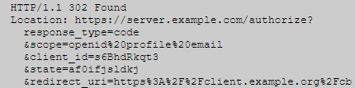

Authorization Code Flow (1/2)
The Authorization Server redirects the Resource Owner’s user agent to an authentication page where the Resource Owner could grant or deny the client’s access request

Slide 11
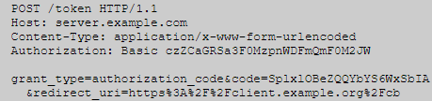
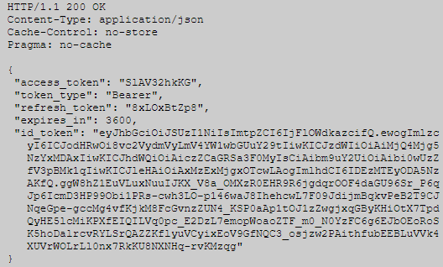
Authorization Code Flow (2/2)

Slide 12
OAuth2 and OpenId Tokens
Access Token
Credential used to access a protected resource.
Represent an authorization issued to the client.
Identity Token
Credential used to authenticate the user on the client side.
Refresh Token
Use to refresh access or identity token after has expired.

Slide 13
Security Consideration
Two main critical security concern in OAuth2:
Cross Site Request Forgery
Exact matching of redirect uri
Always use PKCE
Use always state parameter
Token Stealing
Avoid front-channel communication
If you can, use Reference Token

Slide 14


OAuth2 and OpenId Connect in Asp.net Core
Tell me about Custom
Implementation of
OpenId Connect
OpenId and Oauth2 framework for Asp.net Core.
Brock Allen https://brockallen.com/
Dominick Baier https://leastprivilege.com/

